Slide 1
Managing and Running Python Effectively
Chris Cooling
Senior Teaching Fellow
ECRI

Slide 2
Important Information on Marking your Attendance on Inkpath
I will show you a QR code at the end of the session allowing you to mark your attendance on Inkpath. Please do not mark your attendance until then. If you are a Postgraduate Research student, this is required for receiving your ECRI professional development credit for this course.

Slide 3
Learning Outcomes
Describe the terms “installation”, “environment”, “packages” and “kernel”
Manage Python installations and environments
Utilise Jupyter Notebooks and IDEs to create and run Python code
Create basic Python programs which use command line options

Slide 4
Course Materials
Course materials can be found online here. It is advised you follow the instructions to open them in a GitHub Codespace.

Slide 5
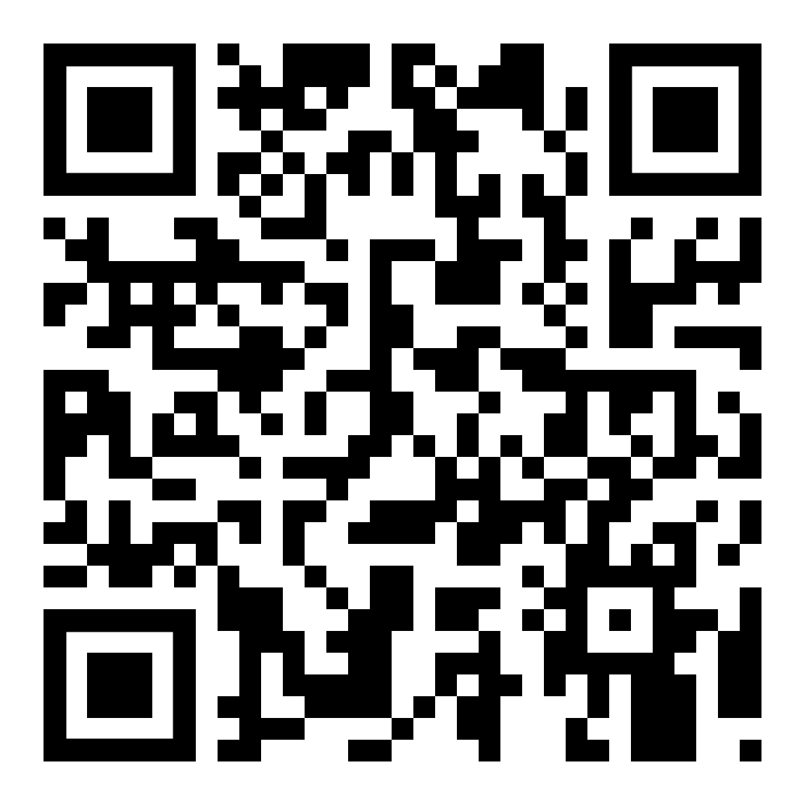
Please take 3 minutes to complete the evaluation
Once you’ve completed this course, please provide feedback
The link is https://ecri.short.gy/feedback-rcds
You should also have received an email with this link
This helps us improve the class for future students

Slide 6
Thank you
Presentation Title
DD/MM/YYYY

